Slide 1

SHOPPING CART WEBSITE
A SPRING BOOT APPLICATION
By - Kavinkumar Bhaskar
Dibya Debayan Dash

Slide 2
Abstract
This is spring boot application used for shopping online . The user will be able to add/remove products from a product list to/from a shopping cart and to place an order.

Slide 3
WALKTHROUGH

Slide 4
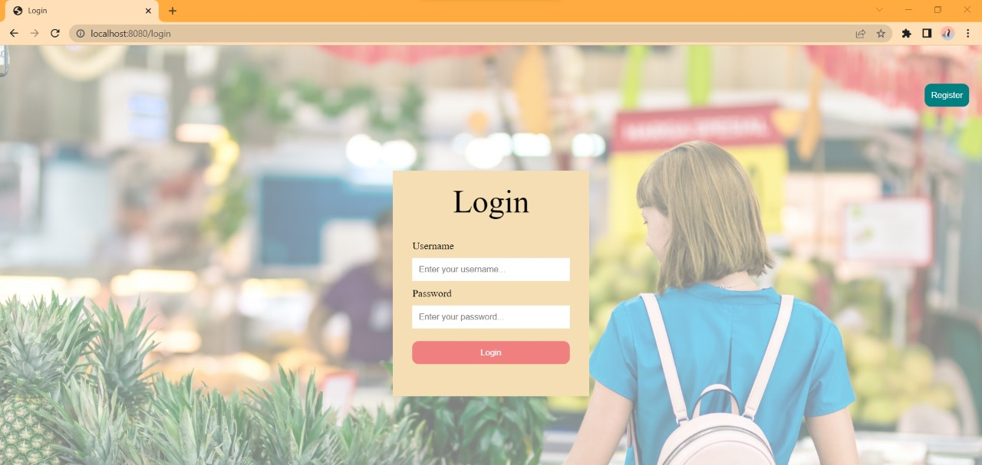
Login
A simple login page for user authentication for shopping cart application. The login page is rendered from “/login” endpoint specified in the controller

Slide 5
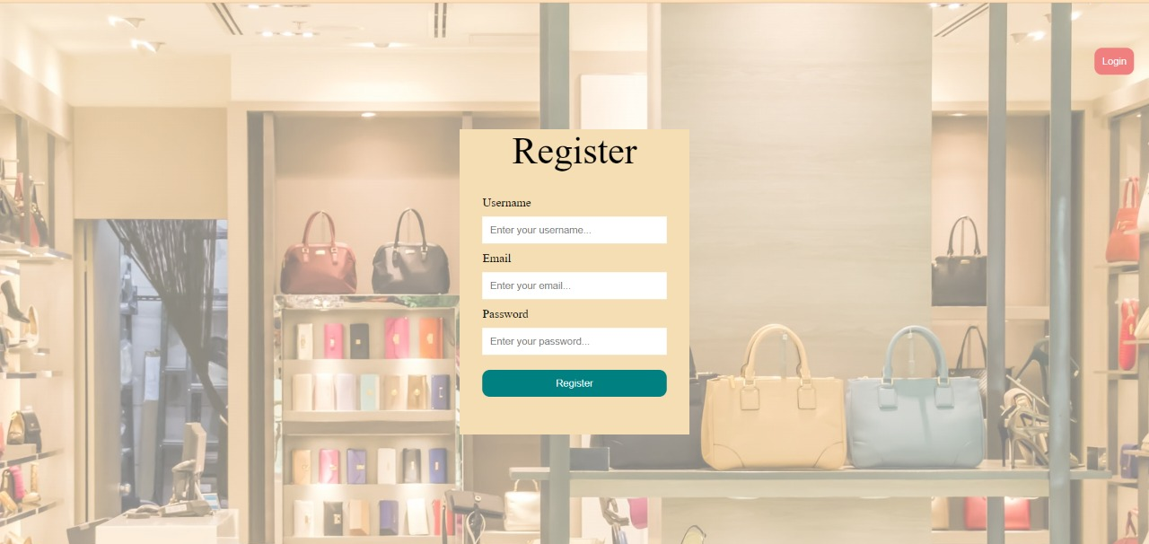
Registration Page
A Registration page for user to register their user credential for the shopping cart application. . The register page is rendered from “/register” endpoint specified in the controller

Slide 6
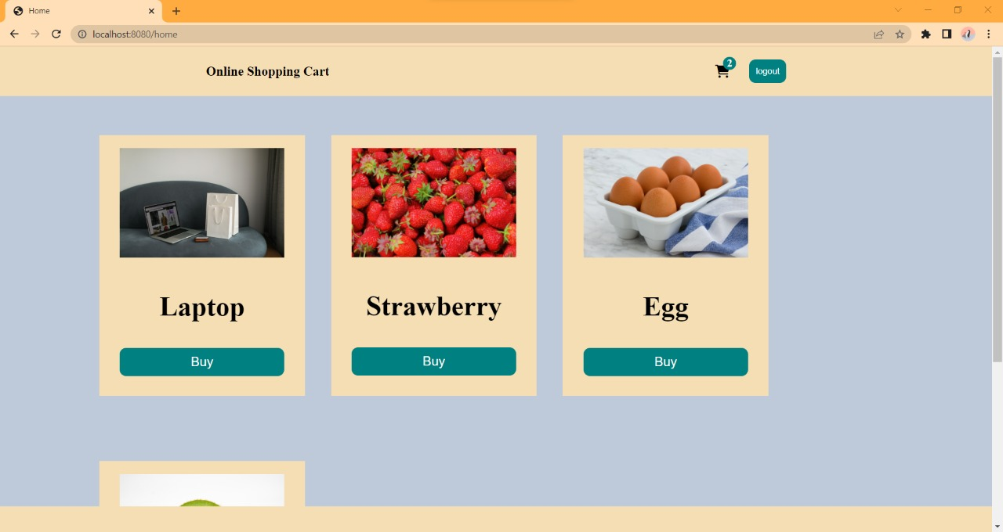
SELECTING ITEMS
User can click on the buy button for selecting item. This function is triggered in “/home” endpoint where items are stored in an array list. Users can also select the items twice if they wanted to repeat the above orders

Slide 7
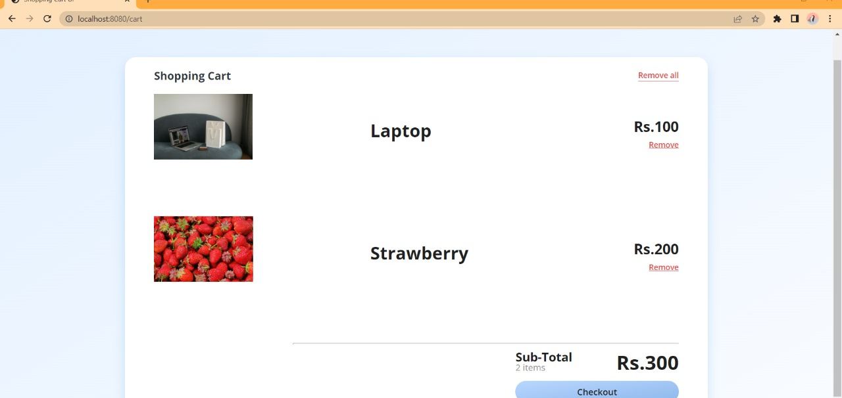
Checkout
Now after click on the cart button user will be redirected to the checkout page which is rendered at “/cart". This is a place where the total amount is displayed . User can remove one or all items which is again rendered at “/removeItem” and “/removeAll” item respectively. After that the user can click checkout

Slide 8
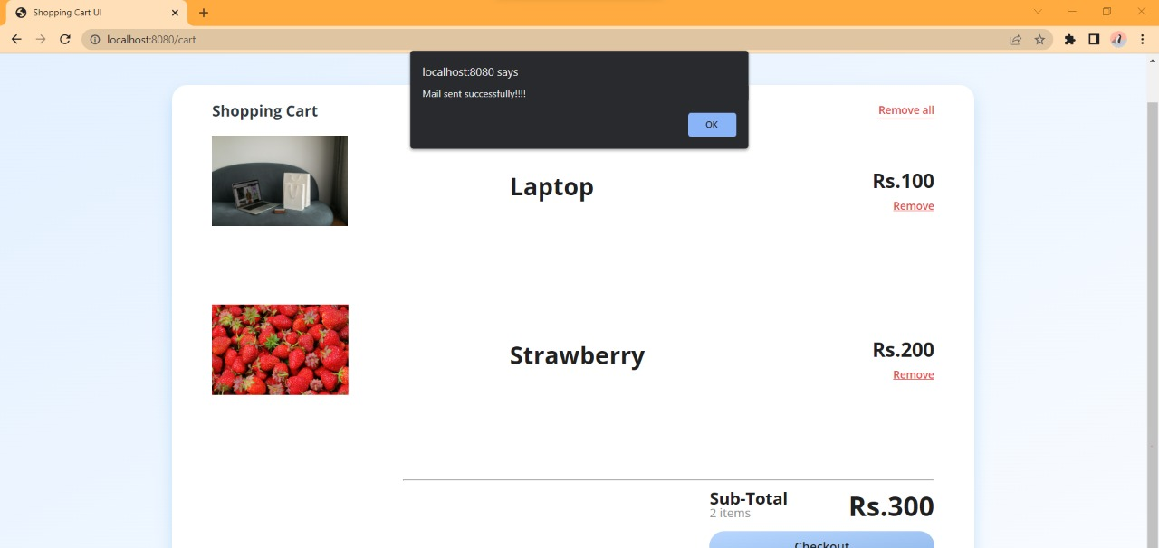
Mail Functionality
After the pressing the checkout the user will receive a mail and a popup notification that his items are added to the cart. This functionality is “/sendmail” endpoint. After that the the user will be redirected to login page.

Slide 9
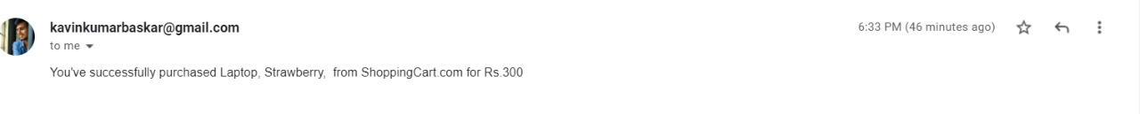
Receiving the conformation mail

Slide 10
GITHUB AND VIDEO LINK
Video link: https://fluvid.com/videos/detail/yxLPdT7yarFEDnMny
Git Hub Link: https://github.com/chapati456/Shopping_Cart

Slide 11

THANK YOU
THANK YOU

